Slide 1
Unit - 5
Software Maintenance

Slide 2
Software Evolution
It is impossible to produce system of any size which do not need to be changed. Once software is put into use, new requirements emerge and existing requirements changes as the business running that software changes.
Parts of the software may have to be modified to correct errors that are found in operation, improve its performance or other non-functional characteristics.
All of this means that, after delivery, software systems always evolve in response to demand for change.

Slide 3
Program Evolution Dynamic
Program evolution dynamic is the study of system change. The majority of work in this area has been carried out by Lehman and Belady. From these studies , they proposed a sets of laws concerning system change.
Law | Description
Continuing change | A program that is used in real-world environment necessarily must change or become progressively less useful in that environment.
Increasing complexity | As an evolving program changes, its structure tends to become more complex. Extra resources must be devoted to preserving and simplify the structure.

Slide 4
Program Evolution Dynamic (cont’d)
Law | Description
Large program evolution | Program evolution is self-regulation process. System attributes such as size, time between release and the number of report errors are approximately invariant for each system release
Organizational stability | Over a program’s lifetime, its rate of development is approximately constant and independent of the resources devoted to the system development
Conservation of familiarity | Over the lifetime of system, the incremental change in each release is approximately constant.

Slide 5
Software Evolution Approaches
There are a number of different strategies for software change.
  Software maintenance
  Architectural transformation
  Software re-engineering.
Software maintenance
  Changes to the software are made in response to changed requirements but the fundamental structure of the software remains stable. This is most common approach used to system change.

Slide 6
Software Maintenance

Slide 7
Software Maintenance
Software maintenance is the general process of changing a system after it has been diverted.
The change may be simple changes to correct coding errors, more extensive changes to correct design errors or significant enhancement to correct specification error or accommodate new requirements.

Slide 8
Maintenance Characteristics
We need to look at maintenance from three different viewpoints:
  the activities required to accomplish the maintenance phase and the impact of a software engineering approach (or lack thereof) on the usefulness of such activities
  the costs associated with the maintenance phase
  the problems that are frequently encountered when software maintenance is undertaken

Slide 9
Types of Maintenance
Maintenance to repair software faults
  Changing a system to correct deficiencies in the way meets
  its requirements
Maintenance to adapt software to a different operating environment
  Changing a system so that it operates in a different environment (computer, OS, etc.) from its initial implementation
Maintenance to add or modify the system’s functionality
  Modifying the system to satisfy new requirements

Slide 10
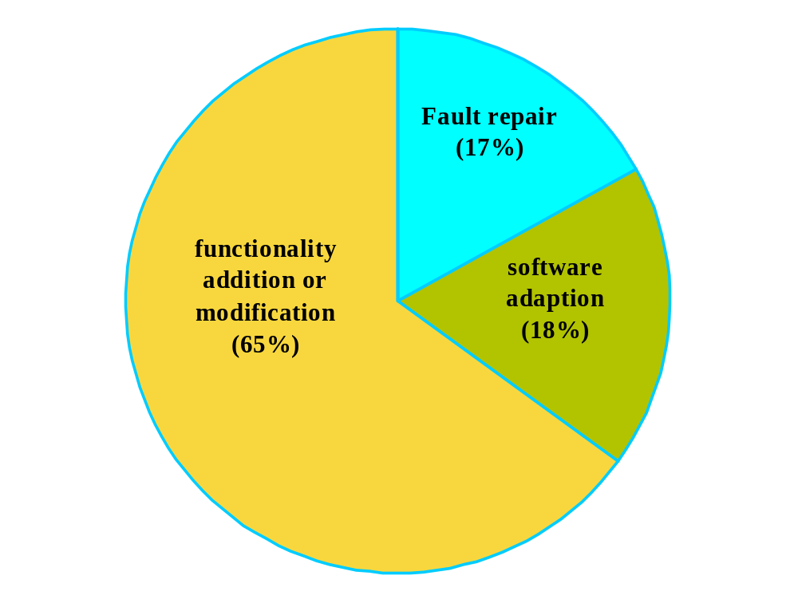
Maintenance effort distribution – good product

Slide 11
Development vs. Maintenance
not directly linked to the real world | directly driven by the real world
freedom | constrained by existing system
defects have no immediate effect | defects disrupt production
methods available | system not using current methods
standards may be enforced | shifting standards, if any

Slide 12
Maintenance Examples
Y2K
  many, many systems had to be updated
  language analyzers (find where changes need to be made)
Anti-Virus Software
  don't usually have to update software, but must send virus definitions

Slide 13
Maintenance Examples (cont’d)
Operating System Patching
  Microsoft, Apple, Linux/Unix
  OS is core to use of computer, so it must be constantly maintained
Commercial Software in General
  customers need to be informed of updates
  updates have to be easily available - web is good tool

Slide 14
The Maintenance Process
Maintenance process vary considerably depending on the types of software being maintained, the development processes used in an organization and people involved in the process.
Change requests
Impact analysis
Release planning
Change implementation
System release
Fault repair
Plat form adaptation
System enhancement
Overview of the Maintenance Process

Slide 15
Why is Maintenance Inefficient?
Factors adversely affect maintenance
  Lack of models or ignorance of available models (73%)
  Lack of documentation (67.6%)
  Lack of time to update existing documentation (54.1%)
Other factors (1994 study)
  Quality of original application
  Documentation quality
  Rotation of maintenance people

Slide 16
Why is Maintenance Inefficient? (cont’d)
More factors (Yip 95 study)
  Lack of human resources
  Different programming styles conflict
  Lack of documentation and tools
  Bad maintenance management
  Documentation policy
  Turnover

Slide 17
9.3 Maintenance Techniques

Slide 18
Architectural Evolution
There is a need to convert many legacy systems from a centralised architecture to a client-server architecture
Change drivers
  Hardware costs. Servers are cheaper than mainframes
  User interface expectations. Users expect graphical user interfaces
  Distributed access to systems. Users wish to access the system from different, geographically separated, computers

Slide 19
User Interface Distribution
UI distribution takes advantage of the local processing power on PCs to implement a graphical user interface
Where there is a clear separation between the UI and the application then the legacy system can be modified to distribute the UI
Otherwise, screen management middleware can translate text interfaces to graphical interfaces

Slide 20
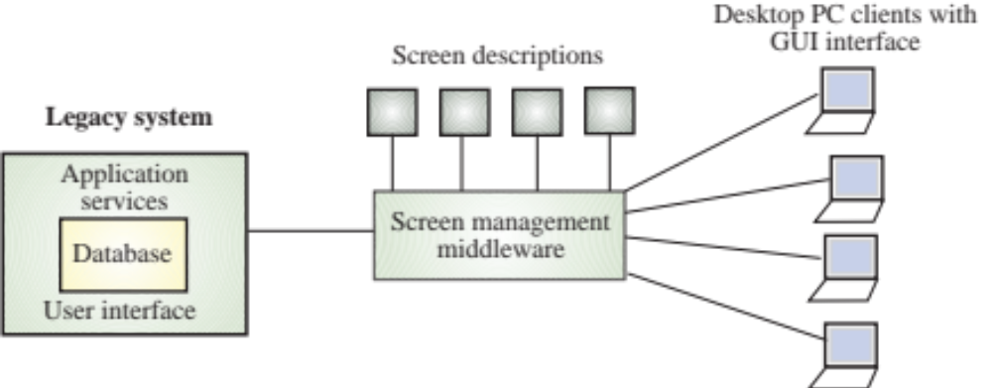
User Interface Distribution

Slide 21
9.4 The Management of Maintenance

Slide 22
Model of Maintenance Effort
Model of maintenance effort M = p + K^(c-d) [PRE2004]
M = total maintenance effort over entire lifecycle
p = productive efforts: analysis, design, code, test
c = complexity due to lack of structured design and documentation
d = degree of familiarization with the system
K = empirically determined constant

Slide 23
Exercise
Calculate the maintenance effort for the project for which the productive efforts is $13000; the complexity due to lack of structured design and documentation is 12; degree of familiarization with the system is 6.564. The empirically determined constant is 6.3

Slide 24
What makes Maintainability complex?
(factors affecting the maintainability of a software Application)
Application age
  (software rust?) older programs were probably worse written and have probably been patched more
Size
  measured in KLOC, number of input/output files
Programming language
  4gls are supposed to produce more maintainable code than 3gls

Slide 25
11.3 Maintenance Problems
Modeling Maintenance Effort: COCOMO II
Size = ASLOC (AA + SU + 0.4DM + 0.3CM + 0.3IM)/100
  ASLOC: number of source lines of code to be adapted
  AA: assessment and assimilation effort
  SU: amount of software understanding required
  DM: percentage of design to be modified
  CM: percentage of code to be modified
  IM: percentage of external code to be integrated

Slide 26
11.3 Maintenance Problems
COCOMO II Rating for SU
 | Very low | Low | Nominal | High | Very high
Structure | Very low cohesion, high coupling, spaghetti code | Moderately low cohesion, high coupling | Reasonably well structured, some weak area | High cohesion, low coupling | Strong modularity, information hiding in data and control structure
Application clarity | No match between program and application worldviews | Some correlation between program and application | Moderate correlation between program and application | Good correlation between program and application | Clear match between program and application worldviews
Self descriptiveness | Obscure code; documentation missing, obscure, or obsolete | Some code commentary headers; some useful documentation | Moderate level of code commentary headers, and documentation | Good code commentary and headers; useful documentation; some weak areas | Self descriptive code; documentation up-to-date , well organized, with design rationale
SU increment | 50 | 40 | 30 | 20 | 10

Slide 27
11.3 Maintenance Problems
COCOMO II Rating AA Effort
Assessment and Assimilation Increment | Level of Assessment and Assimilation Effort
0 | None
2 | Basic component search and documentation
4 | Some component test and evaluation documentation
6 | Considerable component test and evaluation documentation
8 | Extensive component test and evaluation documentation

Slide 28
Calculate the maintenance effort for the project with 10000 adaptable SLOC for which the self descriptiveness is very low and Level of Assessment and Assimilation Effort is none; percentage of design and code to be modified are 10 and 12 % respectively; The code integration is 32 lines.

Slide 29
What makes Maintainability complex? factors affecting the maintainability of a software Application(cont’d)
Processing environment
  files harder to maintain than databases, real-time harder than batch
Analysis and design methodologies
  well designed software is supposed to be much easier to maintain
Structured programming
  there is conflicting evidence whether this really helps

Slide 30
What makes Maintainability complex? factors affecting the maintainability of a software Application(cont’d)
Modularization
  (central thesis of all the oo techniques) small reasonably self contained pieces of code should be easier to maintain
Documentation generation
  maintenance of documentation is as expensive as maintenance of code
End-user involvement
  some researchers believe when end users are more involved maintenance decreases

Slide 31
Problems in Managing Maintenance
Changing priorities
  chaotic nature of maintenance requests, the length of maintenance tasks causing new requests to come along before an ongoing task is done.
Inadequate testing methods
  lack of time set aside for testing, of comprehensive test data, of rigorous testing requirements as a standard for signing off.
Performance measurement difficulties
  how do you measure individual or group performance?
System documentation incomplete or non-existent
  training takes a long time for learning an application so programmers get stuck on one piece of software.
Adapting to the rapidly changing business environment
  hardware and software also become obsolete.

Slide 32
Maintenance Prediction
Maintenance prediction is concerned with assessing which parts of the system may cause problems and have high maintenance costs
  Change acceptance depends on the maintainability of the components affected by the change
  Implementing changes degrades the system and reduces its maintainability
  Maintenance costs depend on the number of changes and costs of change depend on maintainability

Slide 33
Maintenance Prediction (cont’d)
Predicting the number of changes requires understanding of the relationships between a system and its environment
Tightly coupled systems require changes whenever the environment is changed
Factors influencing this relationship are
  Number and complexity of system interfaces
  Number of inherently volatile system requirements
  The business processes where the system is used

Slide 34
Maintenance Prediction (cont’d)
Predictions of maintainability can be made by assessing the complexity of system components
Studies have shown that most maintenance effort is spent on a relatively small number of system components
Complexity depends on
  Complexity of control structures
  Complexity of data structures
  Procedure and module size

Slide 35
Maintenance Prediction (cont’d)
Process measurements may be used to assess maintainability
  Number of requests for corrective maintenance
  Average time required for impact analysis
  Average time taken to implement a change request
  Number of outstanding change requests
If any or all of these is increasing, this may indicate a decline in maintainability

Slide 36
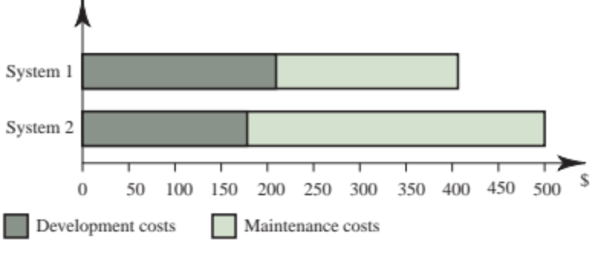
Development/Maintenance Costs [SOM2004]

Slide 37
Maintenance Cost Factors
Team stability
  Maintenance costs are reduced if the same staff are involved with them for some time
Contractual responsibility
  The developers of a system may have no contractual responsibility for maintenance so there is no incentive to design for future change
Staff skills
  Maintenance staff are often inexperienced and have limited domain knowledge
Program age and structure
  As programs age, their structure is degraded and they become harder to understand and change

Slide 38
References
[PRE2004] Roger S. Pressman. Software Engineering: a practitioner’s approach, 6th edition. McGRAW-HILL, 2004.
[SOM2004] Ian Sommerville. Software Engineering, 7th edition. Addison Wesley, 2004

Slide 39
Software Testing and Quality Assurance
Theory and Practice
Chapter 15
Software Reliability
Notes:
Handouts
------------------------------------------------------------------
------------------------------------------------------------------
-------------------------------------------------------------------
--------------------------------------------------------------------

Slide 40
Outline of the Chapter
What is Reliability?
Definitions of Software Reliability
Factors Influencing Software Reliability
Applications of Software Reliability
Operational Profiles
Reliability Models
Summary

Slide 41
What is Reliability?
Reliability is a broad concept.
  It is applied whenever we expect something to behave in a certain way.
Reliability is one of the metrics that are used to measure quality.
It is a user-oriented quality factor relating to system operation.
  Intuitively, if the users of a system rarely experience failure, the system is considered to be more reliable than one that fails more often.
A system without faults is considered to be highly reliable.
  Constructing a correct system is a difficult task.
  Even an incorrect system may be considered to be reliable if the frequency of failure is “acceptable.”
Key concepts in discussing reliability:
  Fault
  Failure
  Time
  Three kinds of time intervals: MTTR, MTTF, MTBF

Slide 42
What is Reliability?
Failure
  A failure is said to occur if the observable outcome of a program execution is different from the expected outcome.
Fault
  The adjudged cause of failure is called a fault.
  Example: A failure may be cause by a defective block of code.
Time
  Time is a key concept in the formulation of reliability. If the time gap between two successive failures is short, we say that the system is less reliable.
  Two forms of time are considered.
    Execution time (τ)
    Calendar time (t)

Slide 43
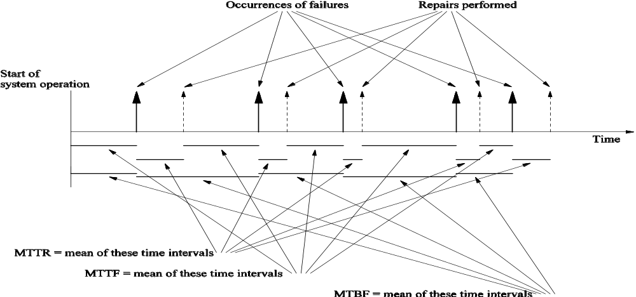
What is Reliability?
MTTF: Mean Time To Failure
MTTR: Mean Time To Repair
MTBF: Mean Time Between Failures (= MTTF + MTTR)
Figure 15.1: Relationship between MTTR, MTTF, and MTBF.

Slide 44
What is Reliability?
Two ways to measure reliability
  Counting failures in periodic intervals
    Observer the trend of cumulative failure count - µ(τ).
  Failure intensity
    Observe the trend of number of failures per unit time – λ(τ).
µ(τ)
  This denotes the total number of failures observed until execution time τ from the beginning of system execution.
λ(τ)
  This denotes the number of failures observed per unit time after τ time units of executing the system from the beginning. This is also called the failure intensity at time τ.
Relationship between λ(τ) and µ(τ)
  λ(τ) = dµ(τ)/dτ

Slide 45
Definitions of Software Reliability
First definition
  Software reliability is defined as the probability of failure-free operation of a software system for a specified time in a specified environment.
    Key elements of the above definition
      Probability of failure-free operation
      Length of time of failure-free operation
      A given execution environment
    Example
      The probability that a PC in a store is up and running for eight hours without crash is 0.99.
Second definition
  Failure intensity is a measure of the reliability of a software system operating in a given environment.
    Example: An air traffic control system fails once in two years.
Comparing the two
  The first puts emphasis on MTTF, whereas the second on count.

Slide 46
Factors Influencing Software Reliability
A user’s perception of the reliability of a software depends upon two categories of information.
  The number of faults present in the software.
  The ways users operate the system.
    This is known as the operational profile.
The fault count in a system is influenced by the following.
  Size and complexity of code
  Characteristics of the development process used
  Education, experience, and training of development personnel
  Operational environment

Slide 47
Applications of Software Reliability
Comparison of software engineering technologies
  What is the cost of adopting a technology?
  What is the return from the technology -- in terms of cost and quality?
Measuring the progress of system testing
  Key question: How of testing has been done?
  The failure intensity measure tells us about the present quality of the system: high intensity means more tests are to be performed.
Controlling the system in operation
  The amount of change to a software for maintenance affects its reliability. Thus the amount of change to be effected in one go is determined by how much reliability we are ready to potentially lose.
Better insight into software development processes
  Quantification of quality gives us a better insight into the development processes.

Slide 48
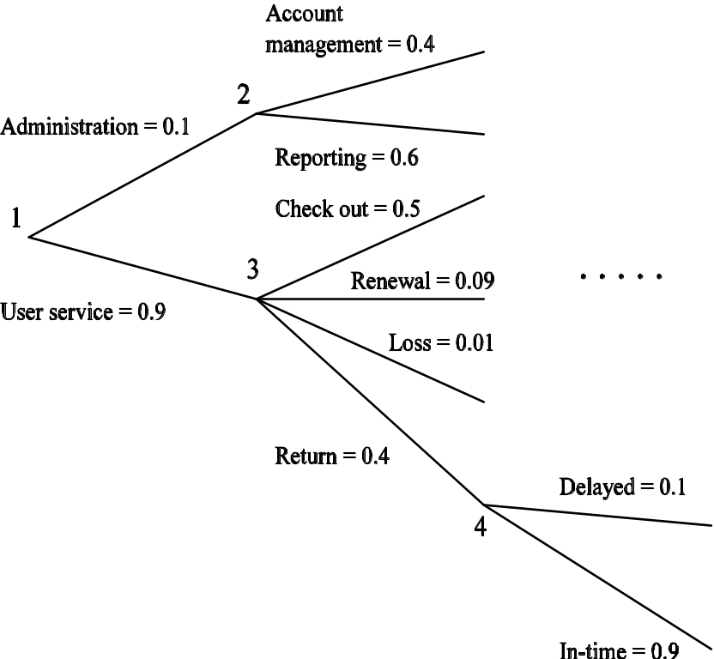
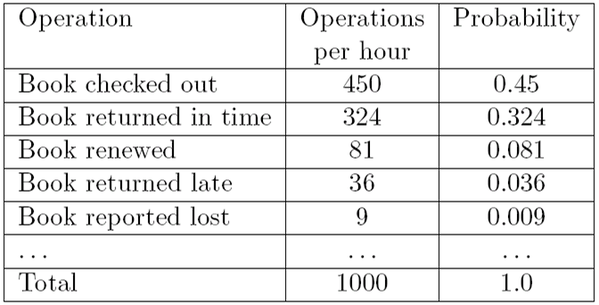
Operational Profiles
Developed at AT&T Bell Labs.
An OP describes how actual users operate a system.
  An OP is a quantitative characterization of how a system will be used.
Two ways to represent operational profiles
  Tabular
  Graphical
Table 15.1: An example of operational profile of a library information system.
Figure 15.2: Graphical representation of operational profile of a library information system.

Slide 49
Operational Profiles
Use of operational profiles
  For accurate estimation of the reliability of a system, test the system in the same way it will be actually used in the field.
Other uses of operational profiles
  Use an OP as a guiding document in designing user interfaces.
    The more frequently used operations should be easy to use.
  Use an OP to design an early version of a software for release.
    This contains the more frequently used operations.
  Use an OP to determine where to put more resources.

Slide 50
Measuring Software Reliability
Measuring software reliability remains a difficult problem because we don't have a good understanding of the nature of software
Even the most obvious product metrics such as software size have not uniform definition.

Slide 51
Measuring Software Reliability
Current practices of software reliability measurement can be divided into four categories:
  Product metrics
  Project management metrics
  Process metrics
  Fault and failure metrics

Slide 52
Measuring Software Reliability
Different categories of software products have different reliability requirements:
  level of reliability required for a software product should be specified in the SRS document.
A good reliability measure should be observer independent,
  so that different people can agree on the reliability.

Slide 53
Measuring Software Reliability
LOC, KLOC, SLOC, KSLOC
McCabe's Complexity Metric
Test coverage metrics
ISO-9000 Quality Management Standards
MTBF
  Once a failure occurs, the next failure is expected after 100 hours of clock time (not running time).

Slide 54
Measuring Software Reliability
Failure Classes
  Transient:
    Transient failures occur only for certain inputs.
  Permanent:
    Permanent failures occur for all input values.
  Recoverable:
    When recoverable failures occur the system recovers with or without operator intervention.
  Unrecoverable:
    the system may have to be restarted.
  Cosmetic:
    May cause minor irritations. Do not lead to incorrect results.
      Eg. mouse button has to be clicked twice instead of once to invoke a GUI function.

Slide 55
Measuring Software Reliability
Errors do not cause failures at the same frequency and severity.
  measuring latent errors alone not enough
The failure rate is observer-dependent
No simple relationship observed between system reliability and the number of latent software defects.
Removing errors from parts of software which are rarely used makes little difference to the perceived reliability.
removing 60% defects from least used parts would lead to only about 3% improvement to product reliability.
Reliability improvements from correction of a single error depends on whether the error belongs to the core or the non-core part of the program.
The perceived reliability depends to a large extent upon how the product is used. In technical terms on its operation profile.

Slide 56
Reliability Models
Main idea
  We develop mathematical models for λ(τ) and µ(τ).
Basic assumptions in developing a reliability model
  Faults in the program are independent.
  Execution time between failures is large w.r.t. instruction execution time.
  Potential test space covers its use space.
  The set of inputs per test run is randomly chosen.
  The fault causing a failure is immediately fixed or else its re-occurrence is not counted again.

Slide 57
Reliability Models
Intuitive idea
  As we observe another system failure and the corresponding fault is fixed, there will be fewer number of faults remaining in the system and the failure intensity will be smaller with each fault fixed.
  In other words, as the cumulative failure count increases, the failure intensity decreases.
Two decrement processes
  Decrement process 1
    The decrease in failure intensity after observing a failure and fixing the corresponding fault is constant.
      This gives us the Basic model.
  Decrement process 2
    The decrease in failure intensity after observing a failure and fixing the corresponding fault is smaller than the previous decrease.
      This gives us the Logarithmic model.

Slide 58
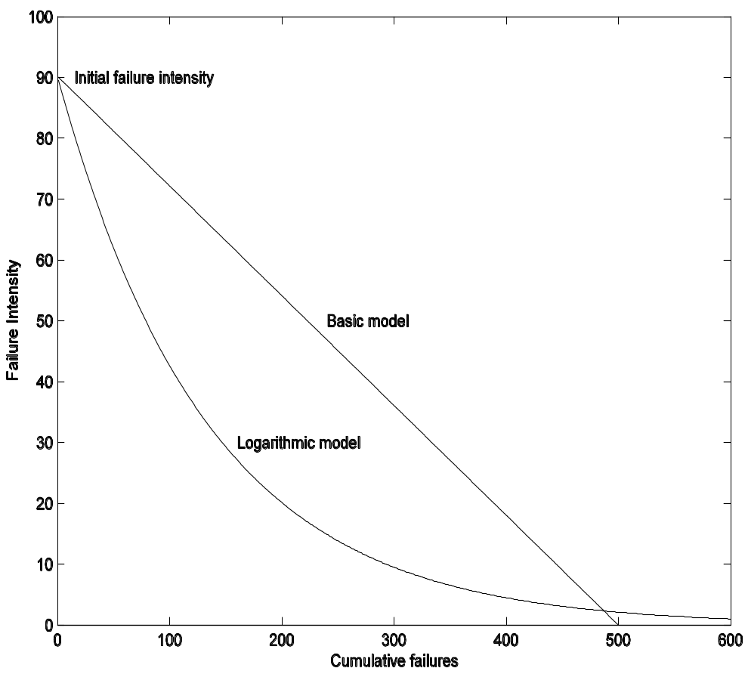
Reliability Models
Parameters of the models
  λ₀: The initial failure intensity observed at the beginning of system testing.
  v₀: The total number of system failures that we expect to observe over infinite time starting from the beginning of system testing.
  θ: A parameter representing n0n-linear drop in failure intensity in the Logarithmic model.
Figure 15.3: Failure intensity λ as a function of cumulative failures µ.

Slide 59
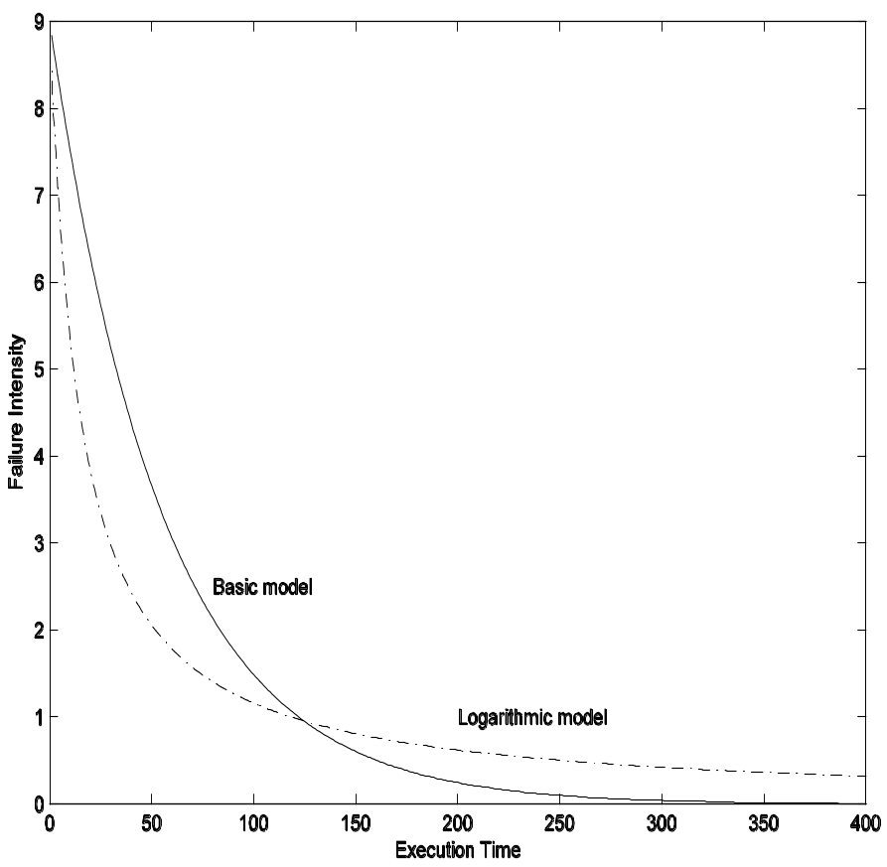
Reliability Models
Basic model
  Assumption: λ(µ) = λ₀ (1 - µ/v₀)
  dµ(τ)/dτ = λ₀ (1 - µ(τ)/v₀)
  µ(τ) = λ₀ (1 - µ/v₀)
  λ(τ) = λ₀.e ^{-λ0 τ/v0}
Logarithmic model
  Assumption: λ(µ) = λ₀e^{-θµ}
  dµ(τ)/dτ = λ₀e^{-θµ(τ)}
  µ(τ) = ln(λ₀θτ + 1)/θ
  λ(τ) = λ₀/(λ₀θτ + 1)
Figure 15.4: Failure intensity λ as a function of execution time τ (λ₀ = 9 failures/unit time, v₀ = 500 failures, θ = 0.0075).

Slide 60
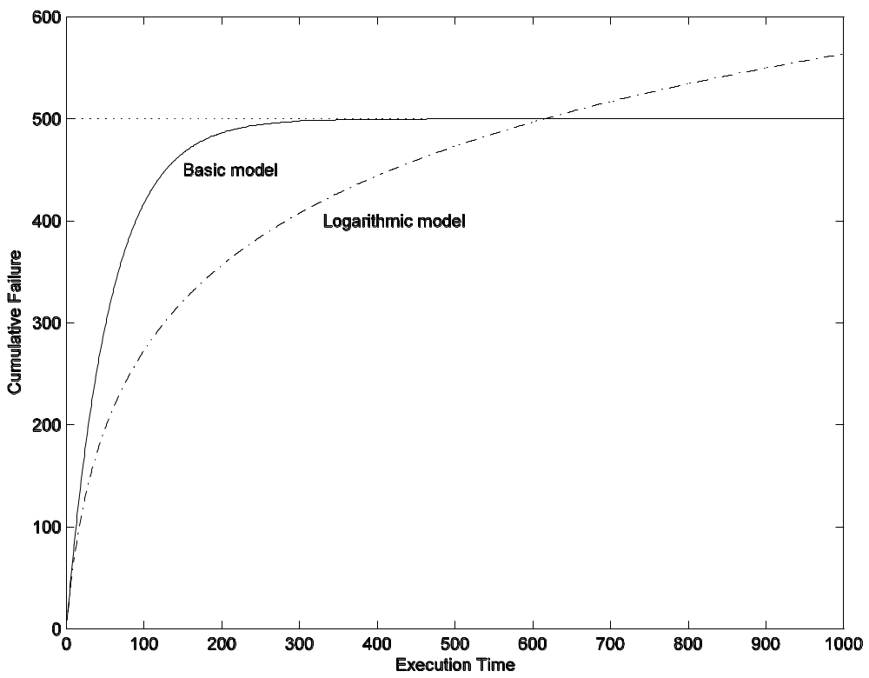
Reliability Models
Figure 15.4: Cumulative failure µ as a function of execution time τ (λ₀ = 9 failures/unit time, v₀ = 500 failures, θ = 0.0075).

Slide 61
Reliability Models
Example
  Assume that a software system is undergoing system level testing. The initial failure intensity of the system was 25 failures/CPU hours, and the current failure intensity is 5 failures/CPU hour. It has been decided by the project manager that the system will be released only after the system reaches a reliability level of at most 0.001 failures/CPU hour. From their experience the management team estimates that the system will experience a total of 1200 failures over infinite time. Calculate the additional length of system testing required before the system can be released.
  The system will experience a total of 1200 failures over infinite time. Thus, we use the Basic model.
  λ_{c} and λ_{r} are the current failure intensity and the failure intensity at the time of release.
  Assume that the current failure intensity has been achieved after executing the system for τ_{c} hours.
  Let λ_{r} be achieved after testing the system for a total of τ_{r} hours.

Slide 62
Reliability Models
(Example continued)
  (τ_{r} - τ_{c}) denotes the additional execution time requires to achieve λ_{r}.
  We can write λ_{c} and λ_{r} as follows.
  λ_{c} = λ₀.e ^{-λ0 τc/v0}
  λ_{r} = λ₀.e ^{-λ0 τr/v0}
  λ_{c} / λ_{r} = (λ₀.e ^{-λ0 τc/v0})/(λ₀.e ^{-λ0 τr/v0})
  = e ^{(τr - τc) λ0/v0}
  ln(λ_{c} / λ_{r}) = (τ_{r} - τ_{c}) λ₀/v₀
  (τ_{r} - τ_{c}) = (v₀/ λ₀)ln(λ_{c} / λ_{r})
  = (1200/25)ln(5/0.001)
  = 408.825 hours
  It is required to test the system for more time so that the CPU runs for another 408.825 hours to achieve the reliability level of 0.001 failures/hour.

Slide 63
Summary
Reliability is a user-oriented quality factor relating to system operation.
The chapter introduced the following.
  Fault and failure
  Execution and calendar time
  Time interval between failures
  Failures in periodic intervals
  Failure intensity
Software reliability was defined in two ways.
  The probability of failure-free operation of a system for a specified time in a given environment.
  Failure intensity is a measure of reliability.
User’s perception of reliability:
  The number of faults in a system.
  How a user operates a system.
The number of faults in a system is influenced by the following:
  Size and complexity of code.
  Development process.
  Personnel quality.
  Operational environment
Operational profile
  A quantitative characterization of how actual users operate a system.
  Tabular and graphical representation
Applications of reliability metric
Reliability models
  Six assumptions
  Two models
    Basic
    Logarithmic

